Slide 1

Process Quality Assurance (PQA)
Objective
PQA Plan
PQA schedule
Audit Inputs
Audit Incident log
Audit NC analysis & reporting
Process Improvement incidents

Slide 2
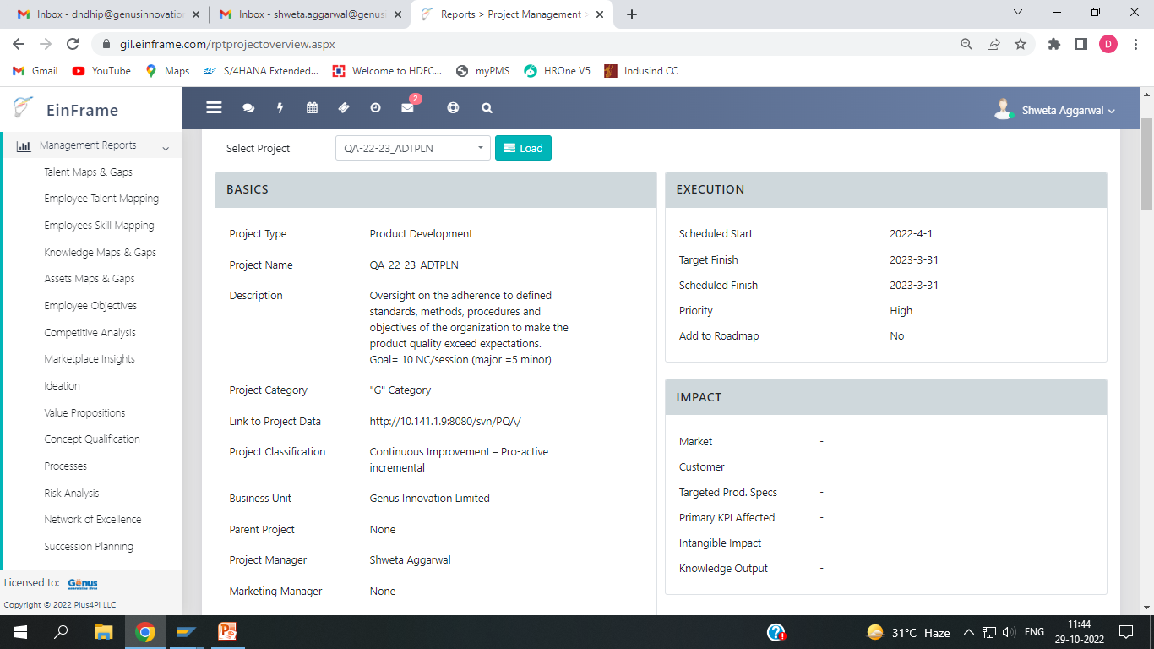
Why PQA?
To objectively evaluate the Process Areas and Work Products.
To provide stakeholders and management with objective insight into compliance.
To track and communicate issues to ensure that they are resolved.

Slide 3
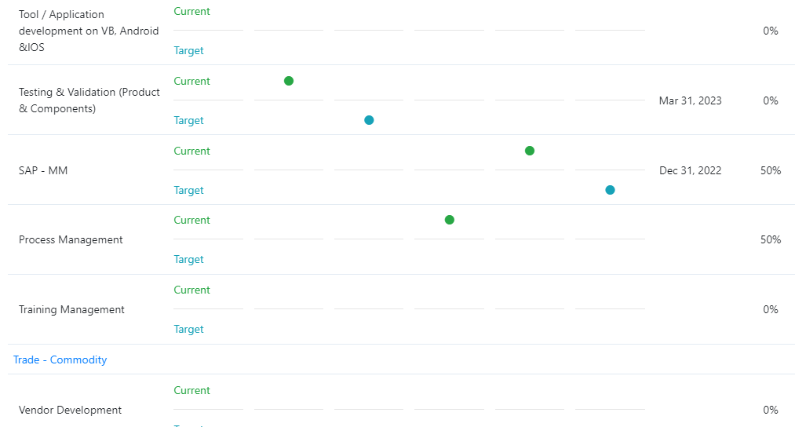
PQA resource
Personal Data Base PQA is additionally responsible for providing process facilitation and assistance to the project team members.
PQA is independent of the project and not directly supervised by any stakeholder, and maintain a reporting channel to Senior Management.

Slide 4
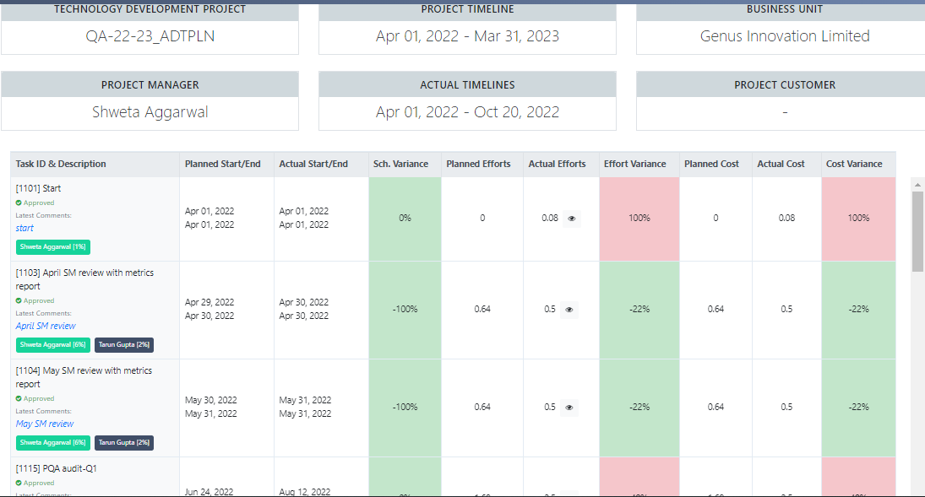
PQA activities
PQA tasks/schedule is for conducting Organization Audits, audit report analysis & review with senior management, PQA audit.

Slide 5
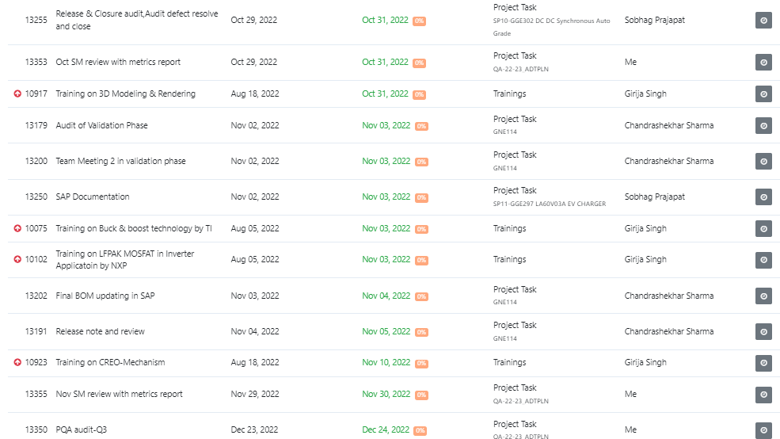
Tasks assigned to me
At Einframe home screen, there are pending tasks assigned to me. This reflects combined schedule for me.

Slide 6
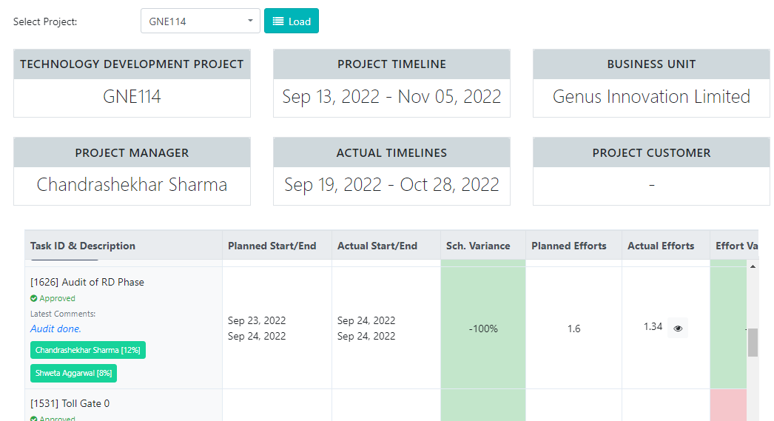
Audit task in Project’s tasks
Project’s audit task is planned in project tasks itself, and assigned to me as per mutual agreement in kick off meeting.

Slide 7
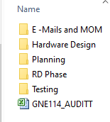
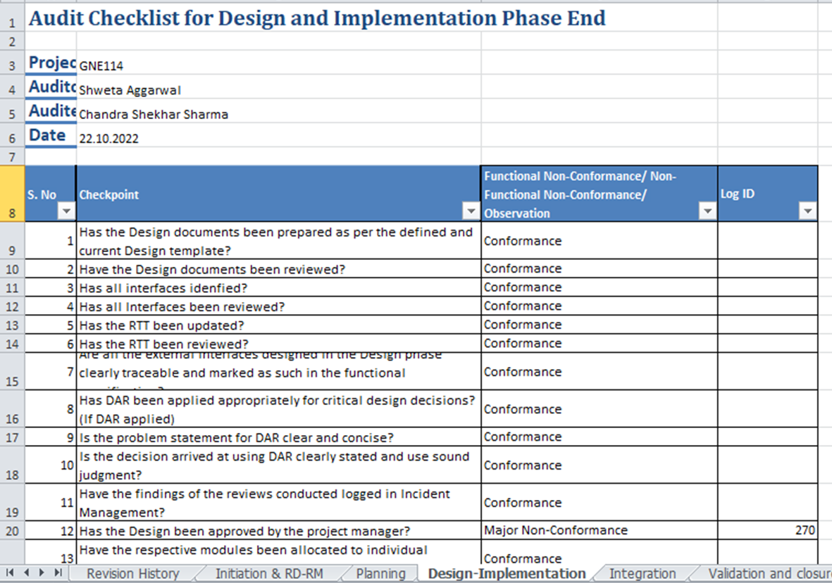
Audit Inputs
Audit Checklists
Projects’ Work Products
Organizational and Project Standards, and Process Definitions

Slide 8
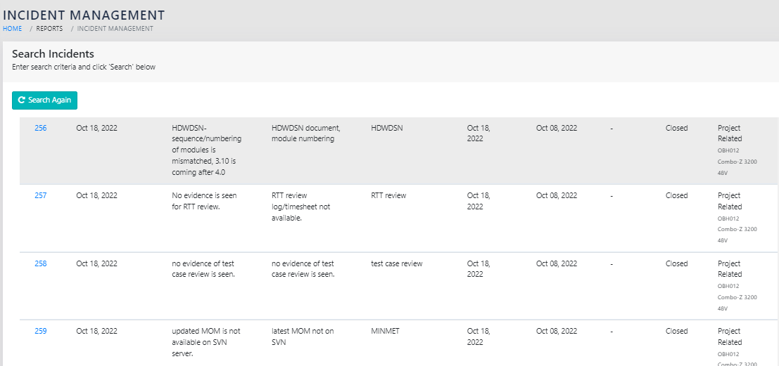
PQA classify findings as Non-Functional/Functional/Observations based on Audit guidelines & definitions provided in procedure.
Audit Incident log

Slide 9
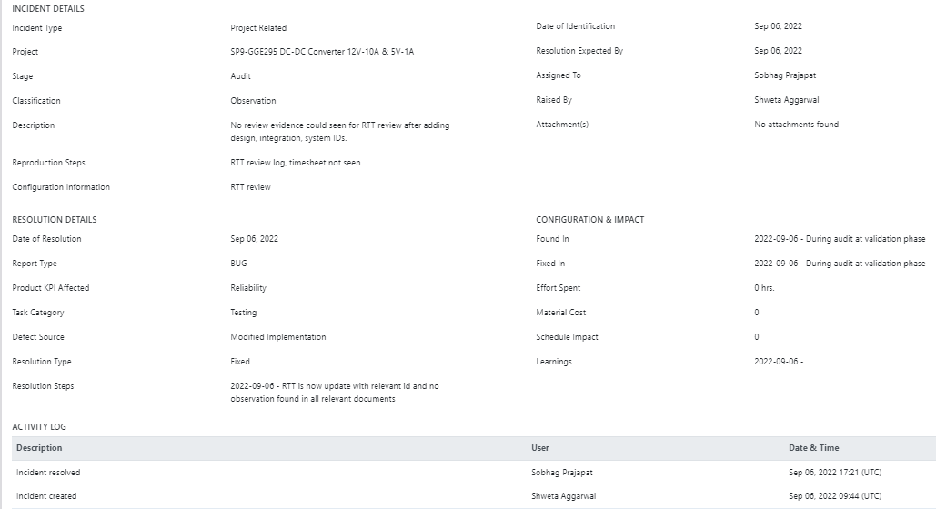
Audit incident closure
PQA discuss the timelines to close the NCs with the Auditee, After resolving the NC's by Stakeholder, I check resolution and re-open if not suitable action. I ensure that all audit findings are resolved.

Slide 10
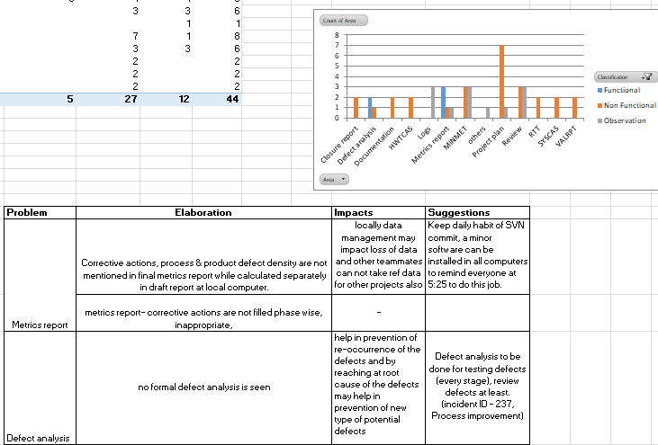
Audit NC analysis & report
End of the month, I generate “Audit Report” using “Audit Reporting Tool” (TOOL_ADTRPT) and send this report to PEG Head for identifying Process Improvement Opportunities.
Discuss audit report and PQA activities monthly with senior management.

Slide 11
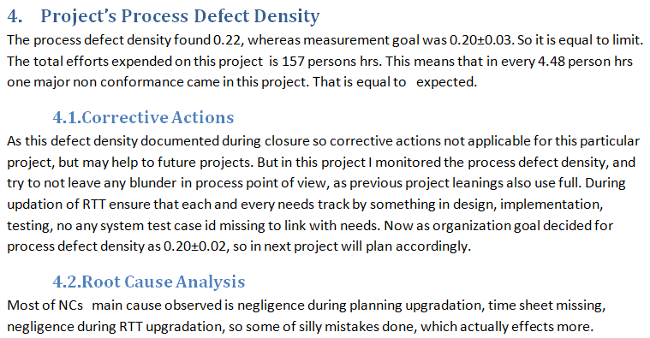
Project’s process defect density

Slide 12
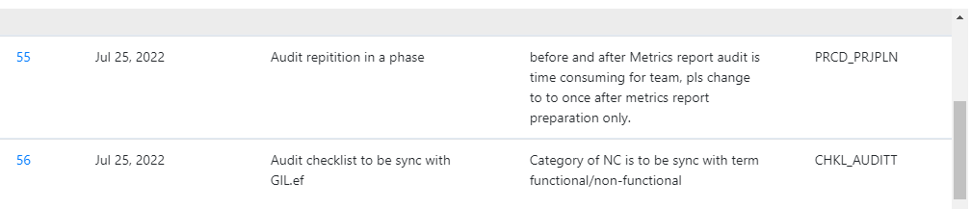
Process Improvement incidents
If any best practices and process improvement opportunities are identified, I submit them to the PEG using “Process Improvement Incidents”.

